Slide 1
Tech Interview Prep:
SQL vs. NoSQL and Read Replica Scaling
Section 1: SQL vs. NoSQL: Beyond the Buzzwords
Section 2: Read Replicas & Scaling the Read Path
Section 3: Synthesis & Architectural Rule of Thumb
Name: Dara Sen
Class: AD371 (Application architecture)

Slide 2
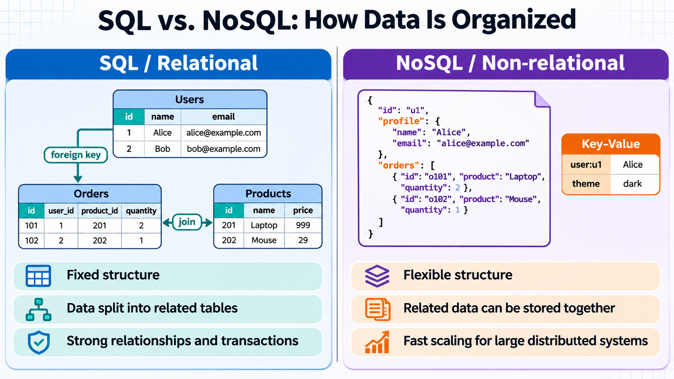
Section 1.1: SQL vs. NoSQL Comparison

Slide 3
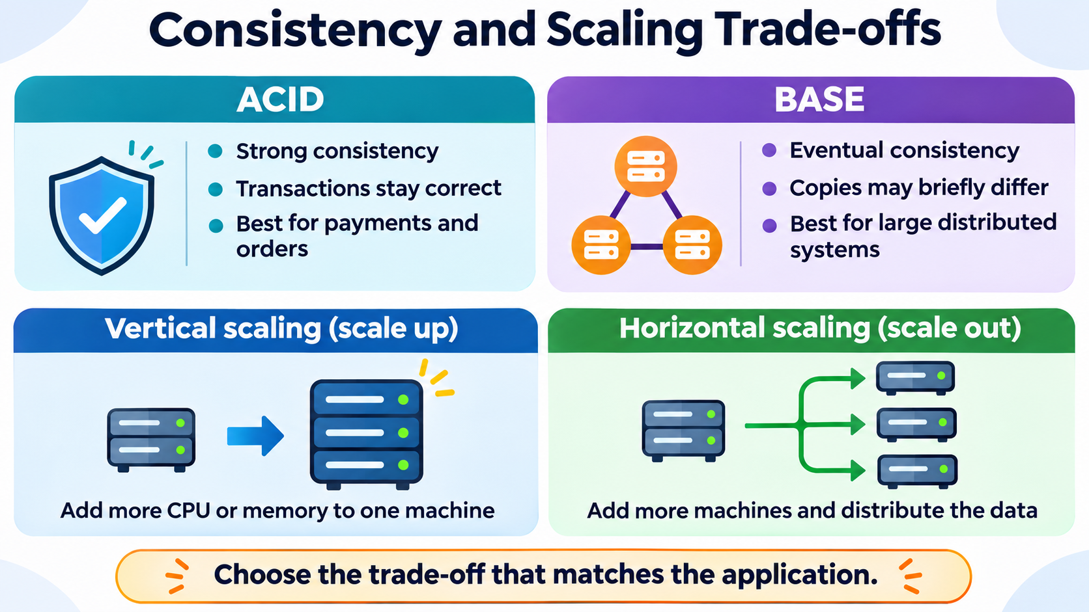
Section 1.2: ACID, BASE, and Scaling

Slide 4
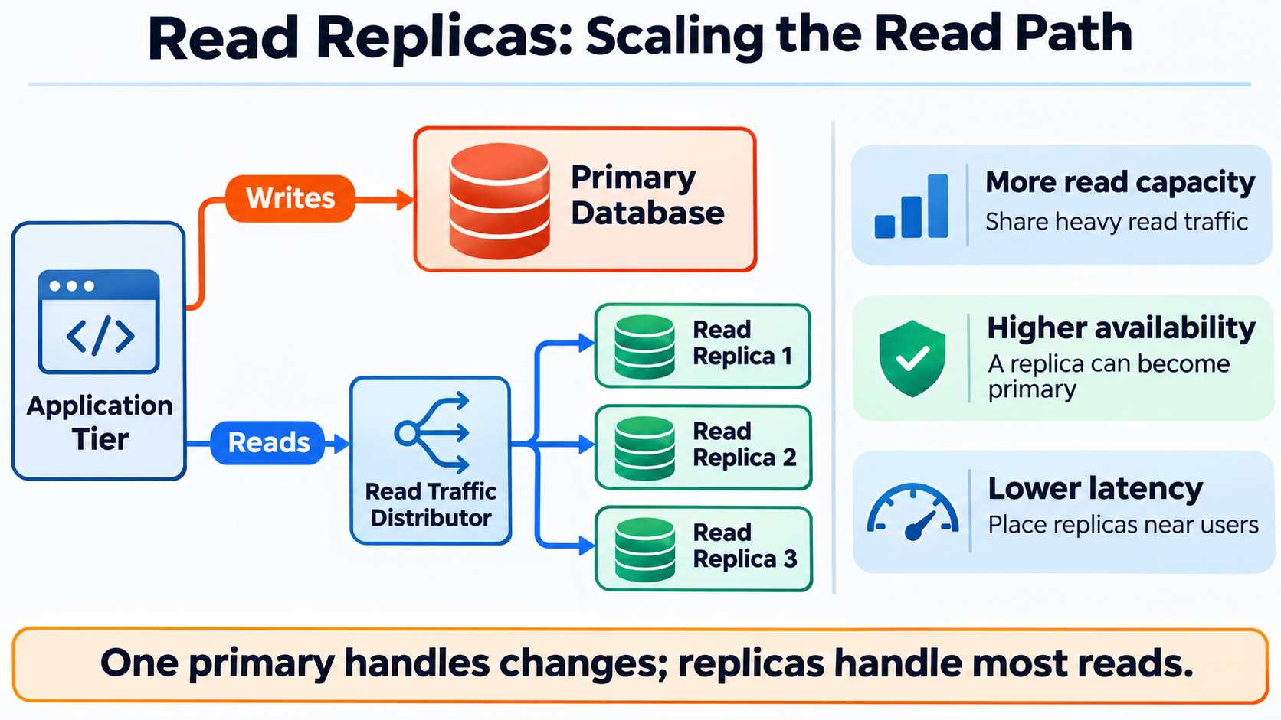
Section 2.1: Read Replicas and Benefits

Slide 5
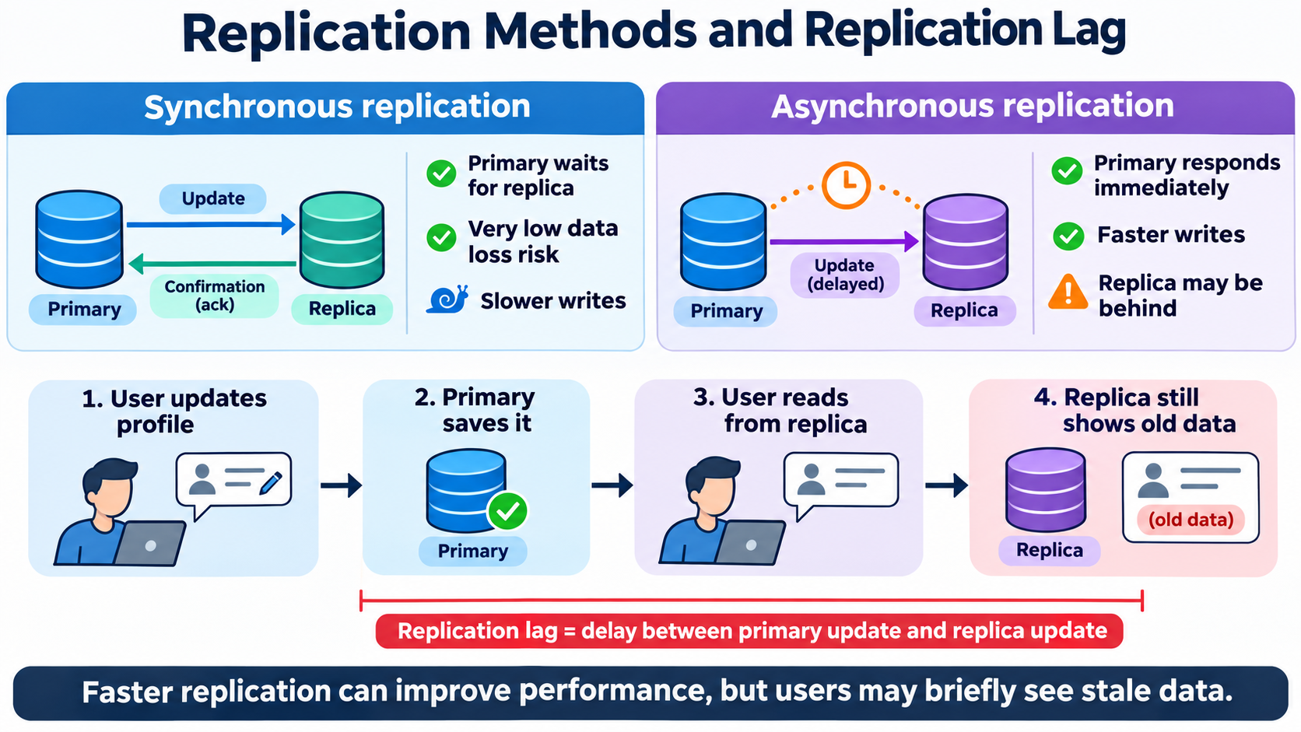
Section 2.2: Replication Methods and Replication Lag

Slide 6
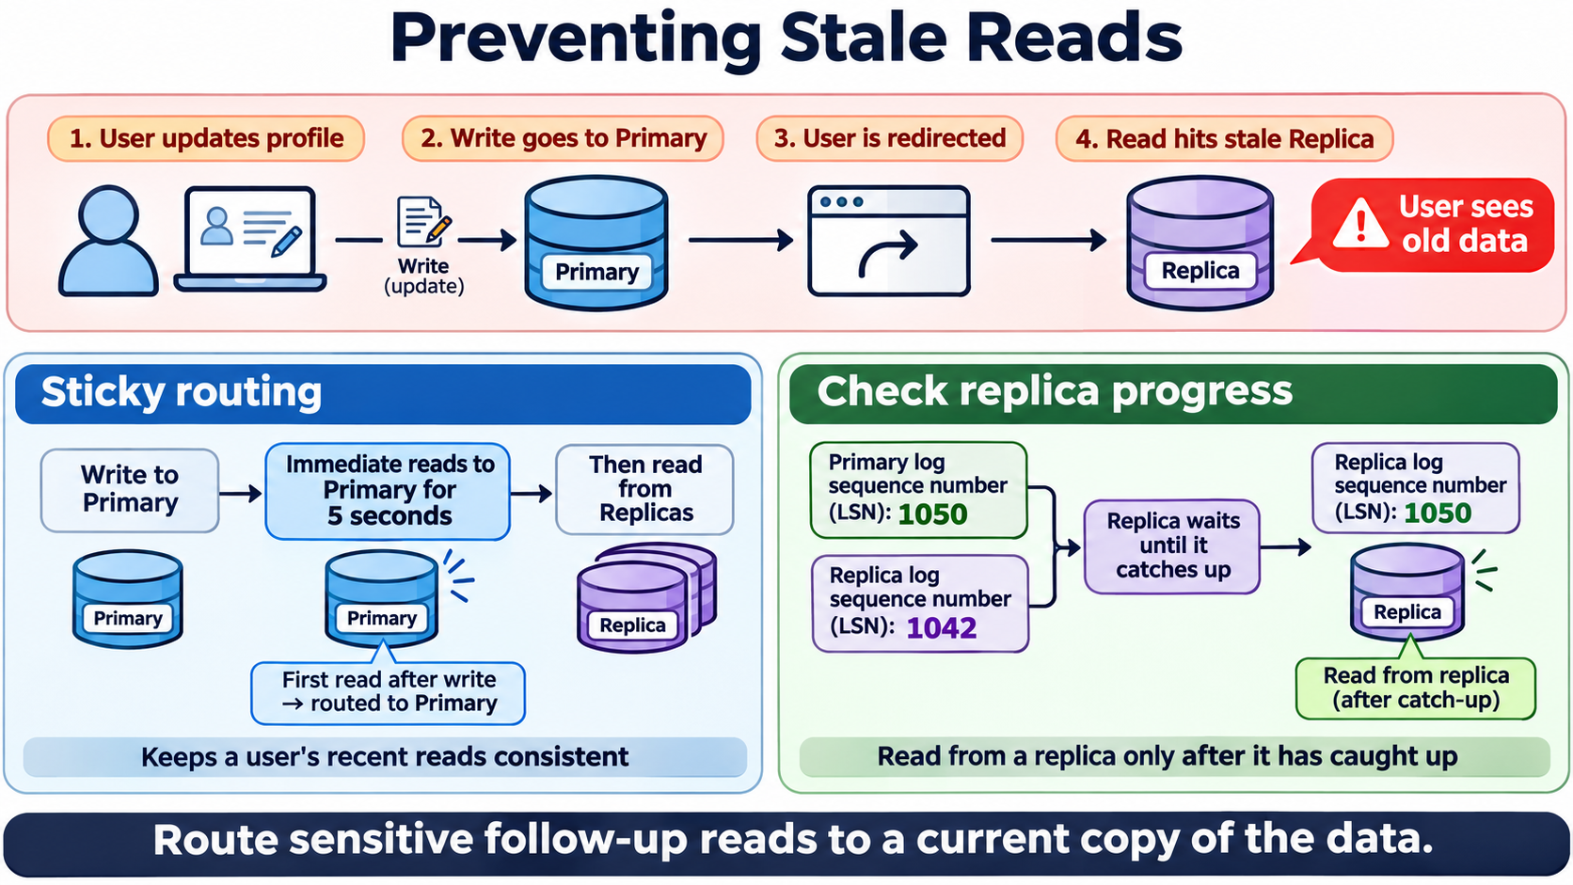
Section 2.3: ‘Read-Your-Own-Writes’ Problem and Solutions

Slide 7
Section 3: Synthesis & Architectural Rule of Thumb
Strong Consistency vs. Eventual Consistency
Primary Database vs. Replicas
Preventing Stale Reads (Sticky Routing / Check Replica Progress)

